Slide 1
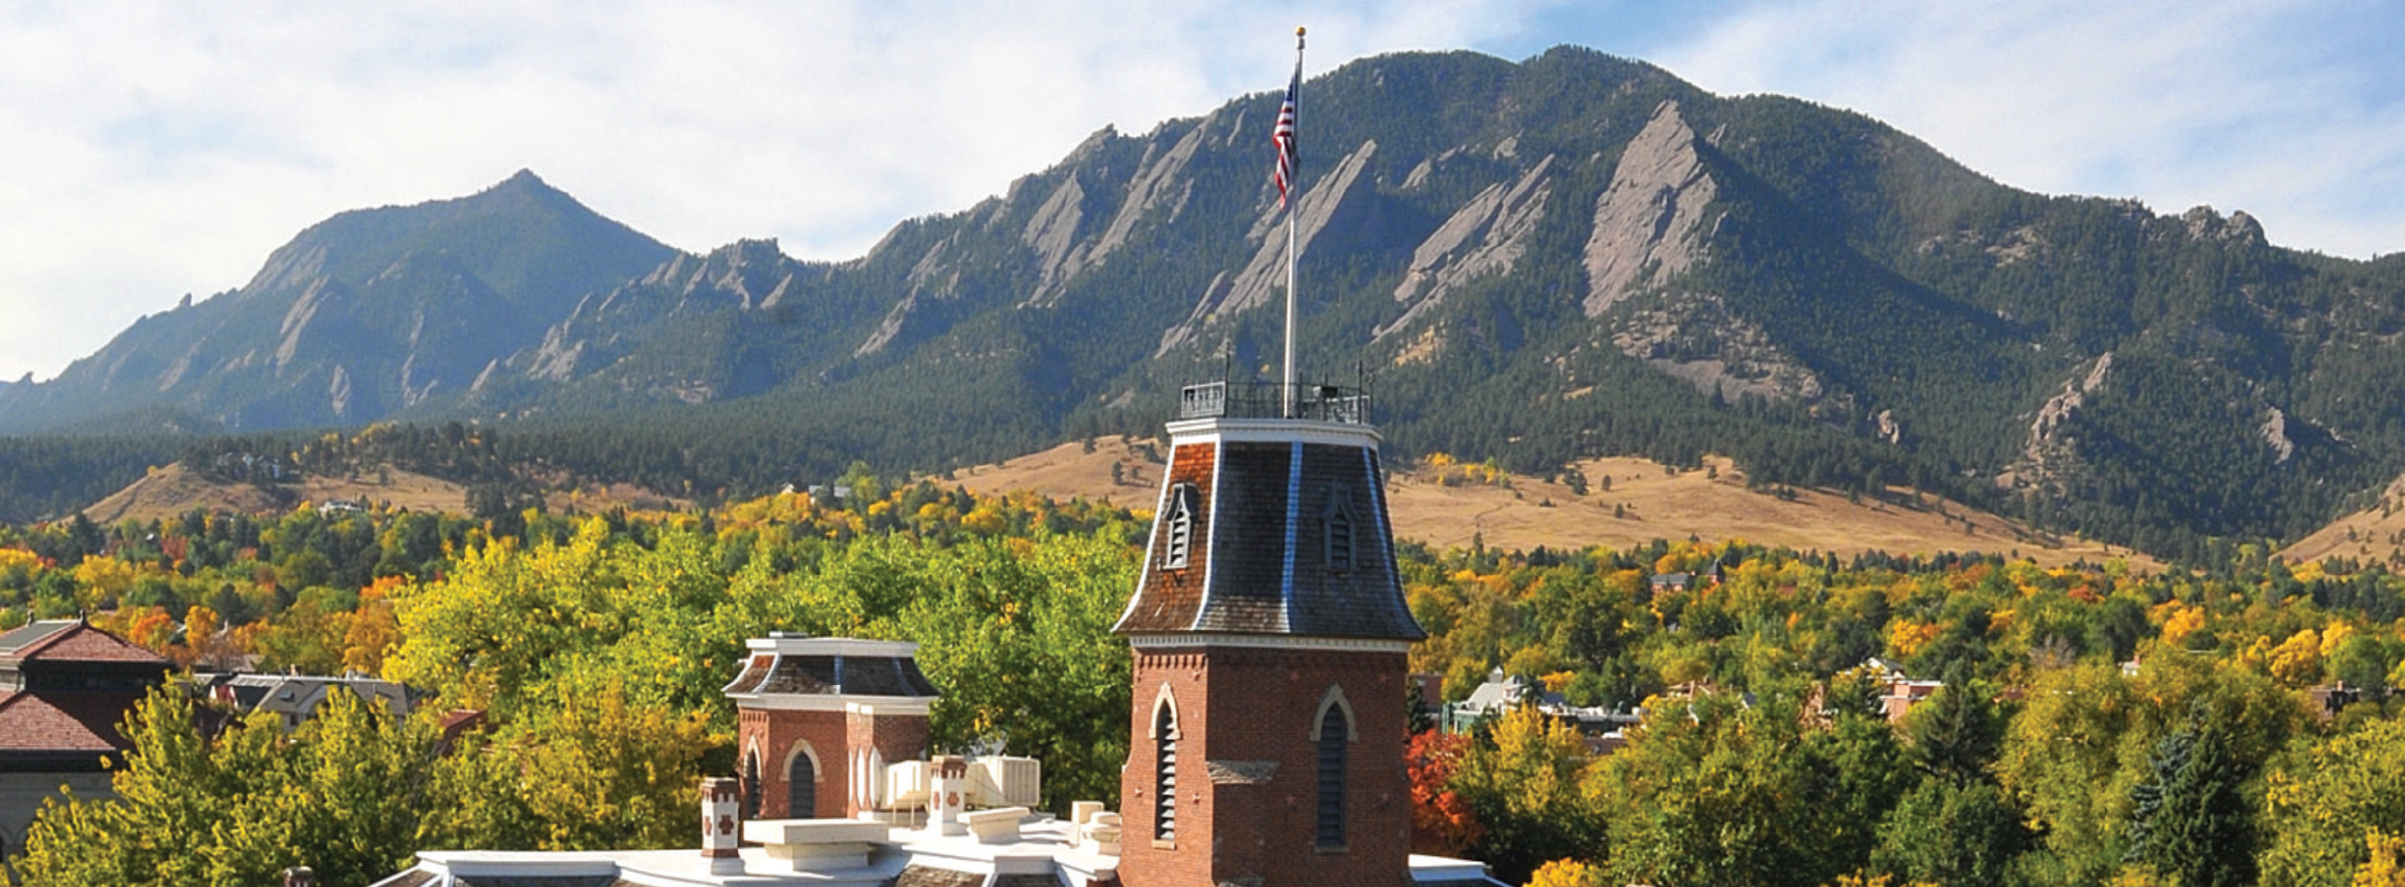
Launching Careers in HPC at RMACC Institutions
Craig Earley
University of Colorado Boulder
Research Computing

Slide 2

View the Slides
https://github.com/ResearchComputing/2025_rmacc/student_cohort

Slide 3
CU Boulder Research Computing
CU Boulder OIT Research Computing
R1 Doctoral University
Many services are available to users associated with institutions that are members of the Rocky Mountain Advanced Computing Consortium (RMACC)
High Performance Computing (HPC), cloud computing assistance, storage
Prior supercomputers: Janus, RMACC Summit

Slide 4
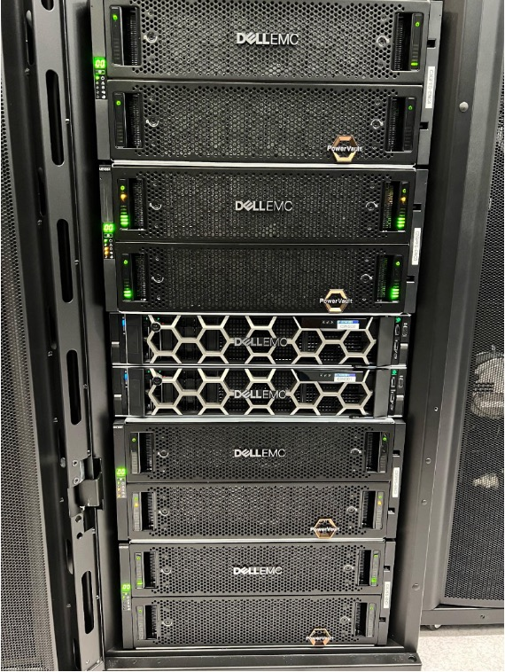
Alpine Supercomputer
Collaborative platform: CU Boulder, CSU, Anschutz, RMACC
455 compute nodes, 28,080 cores, 74 GPUs, 24 high-mem nodes
1.9 PB GPFS scratch filesystem
Continued growth in 2024
1779 users, +28%
148M core hours, +25%
>$136.8M in research grants, +35%

Slide 5
RMACC Student Cohort
Opportunity for undergraduate and graduate students to learn HPC system administration by learning from and shadowing RC staff
RMACC student cohort (17 for 2 events)
Target: workforce development and opportunities in HPC
17 have participated in some capacity: 11 on-site January, 7 on-site July (+1 remote)
Students have come from 8 institutions including CU Boulder

Slide 6
Format of Experience
Initially developed over two cohorts, consisting of:
a remote experience for most of a semester
a week-long in-person experience
Iteration, student feedback were key

Slide 7
Curriculum
Work and subject matter has consisted of some combination of:
Hardware and quote evaluation
Cluster configuration
Job submission and optimization
Data center experience
In-person discussions with HPC staff
Resume review
Mix of lecture and exercises

Slide 8
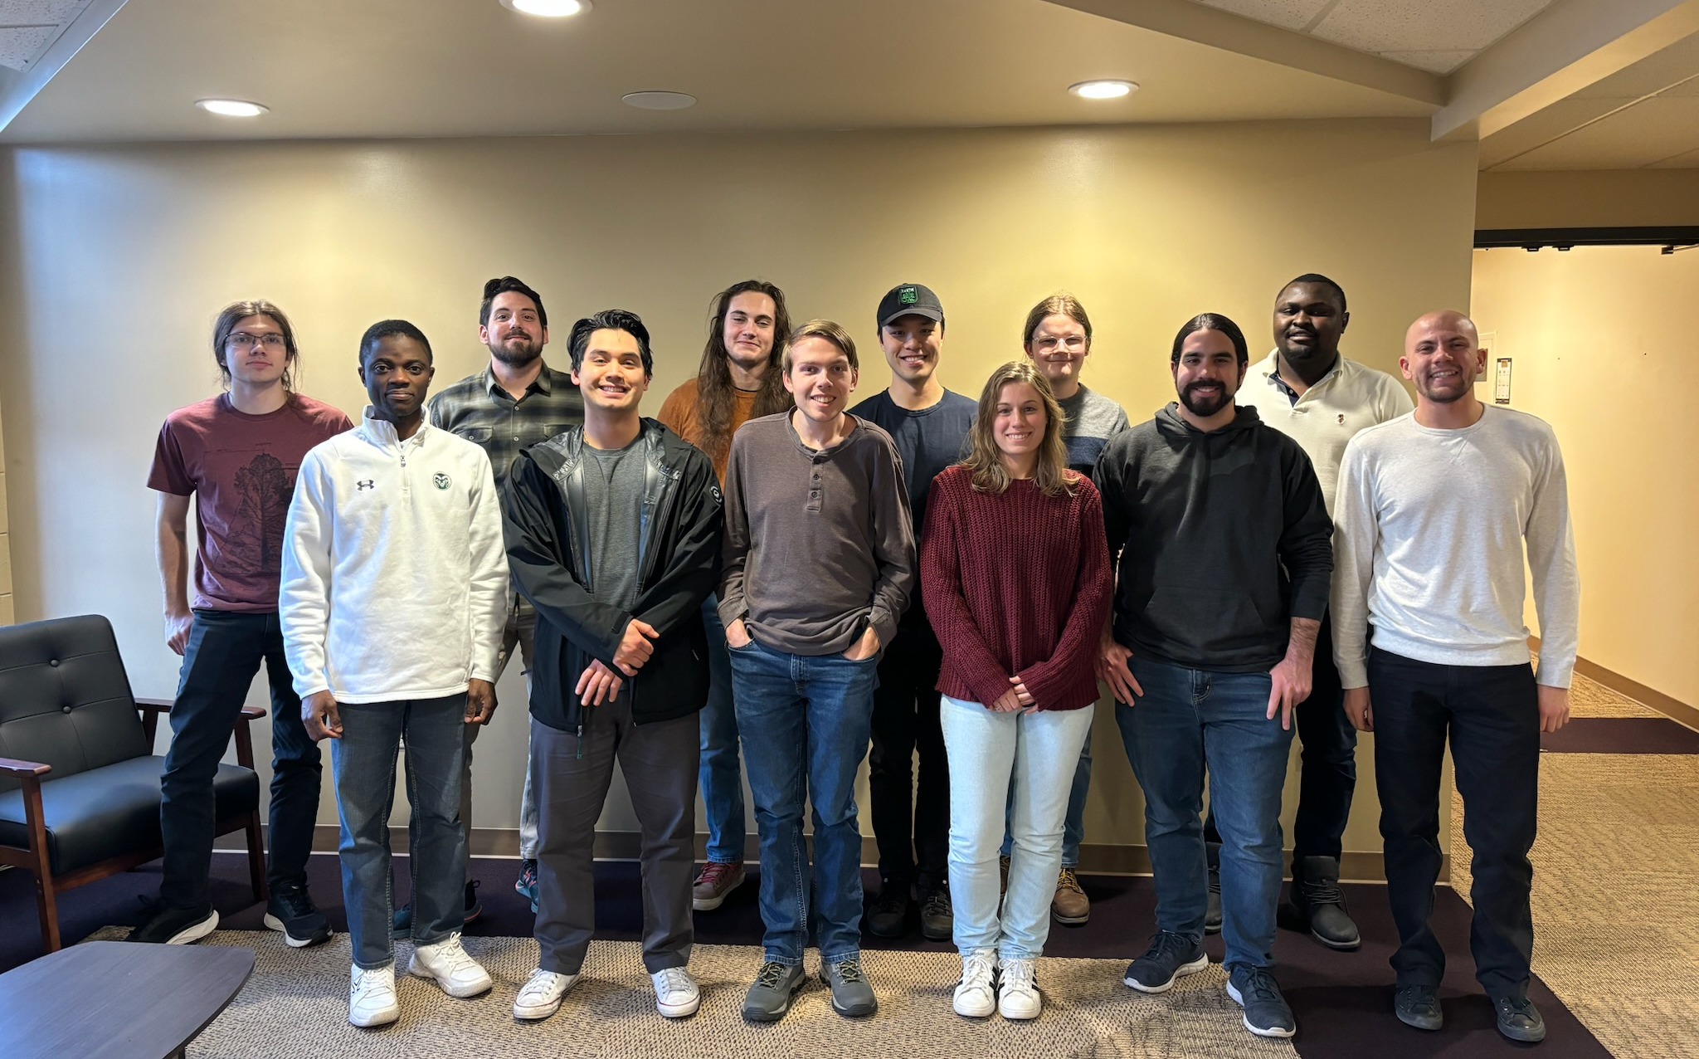
Experience 1: January 2024
January 2024
Week on site
Removal of Summit hardware from CU Boulder’s HPCF data center

Slide 9
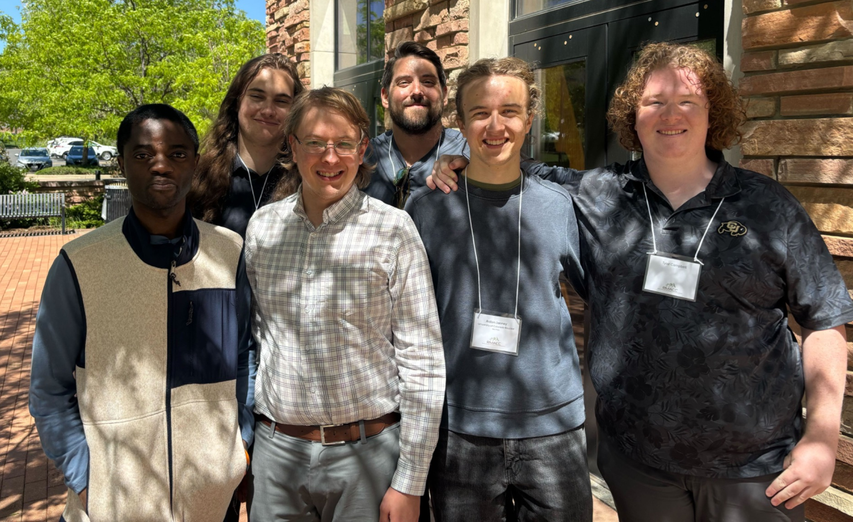
RMACC Symposium 2024
May 2024
Gathered to meet with RC staff and director as well as with members of RMACC institutions
New and returning members

Slide 10
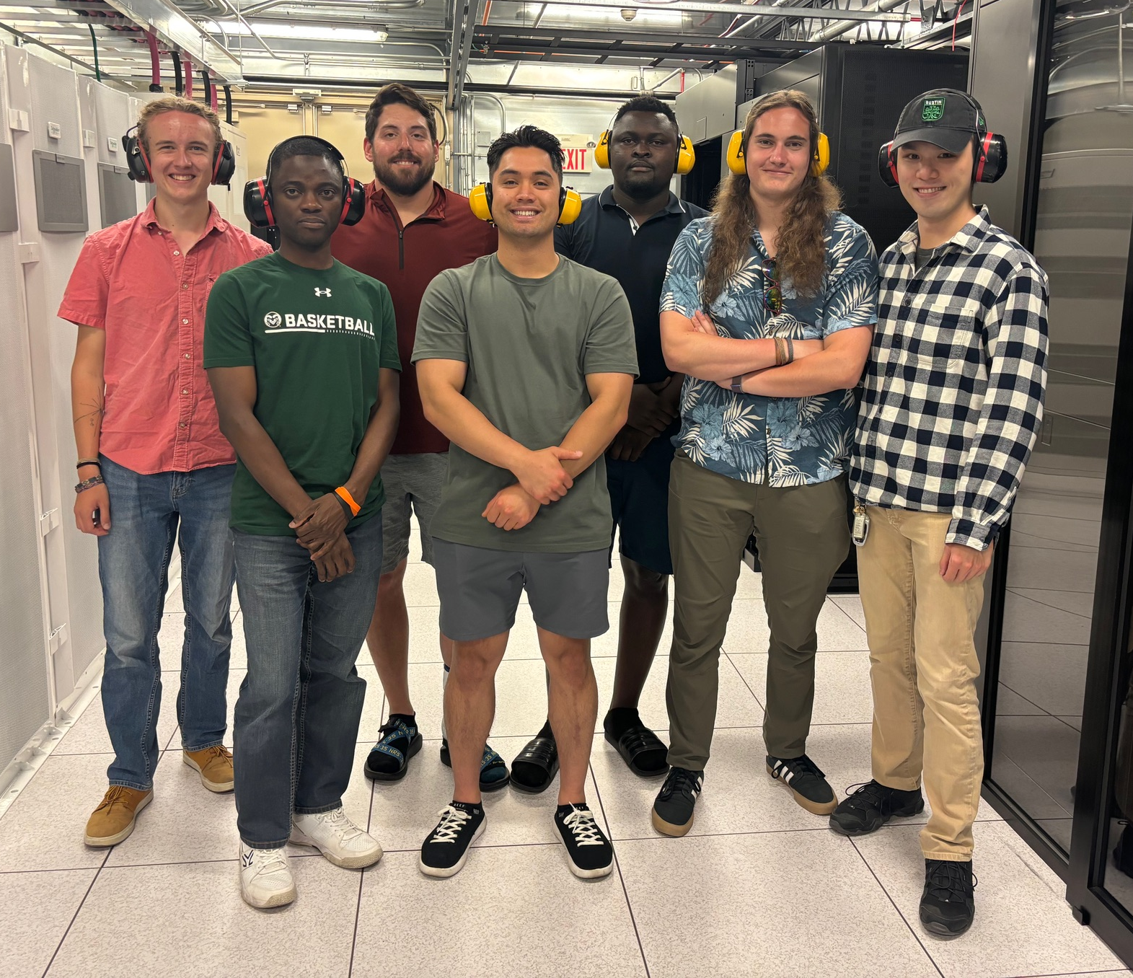
Experience 2: August 2024
August 2024
Week on site
In-depth conversations with members of CURC staff regarding job responsibilities in HPC
User support, data center, system administration
Rollout - CPU nodes, Alpine
(1 remote participant)

Slide 11
Future of the program
Next cohort experience will be at an in-person session August 11-15, 2025
Students from RMACC member institutions have been invited to participate
Next experience has drawn substantial student interest
Compiling educational material into a shareable form for use in increasing opportunities in HPC

Slide 12
Acknowledgements
NSF CC* for RMACC
OAC #2322260
Investigators:
Shelley Knuth (Principal Investigator)
Jan Mandel (Co-PI)
Mitchell McGlaughlin (Co-PI)
Joel Sharbrough (Co-PI)
Jarrod Schiffbauer (Co-PI)
CU Boulder Support
OIT Data Center Operations
Brandon Reyes, CU Boulder OIT Research Computing User Support Team
Kyle Reinholt, CU Boulder OIT Research Computing Research Infrastructure Team

Slide 13

Thank you!
Visit our websites
Research Computing www.colorado.edu/rc
RMACC www.rmacc.org
Questions?
Email RC: rc-help@colorado.edu

